Slide 1
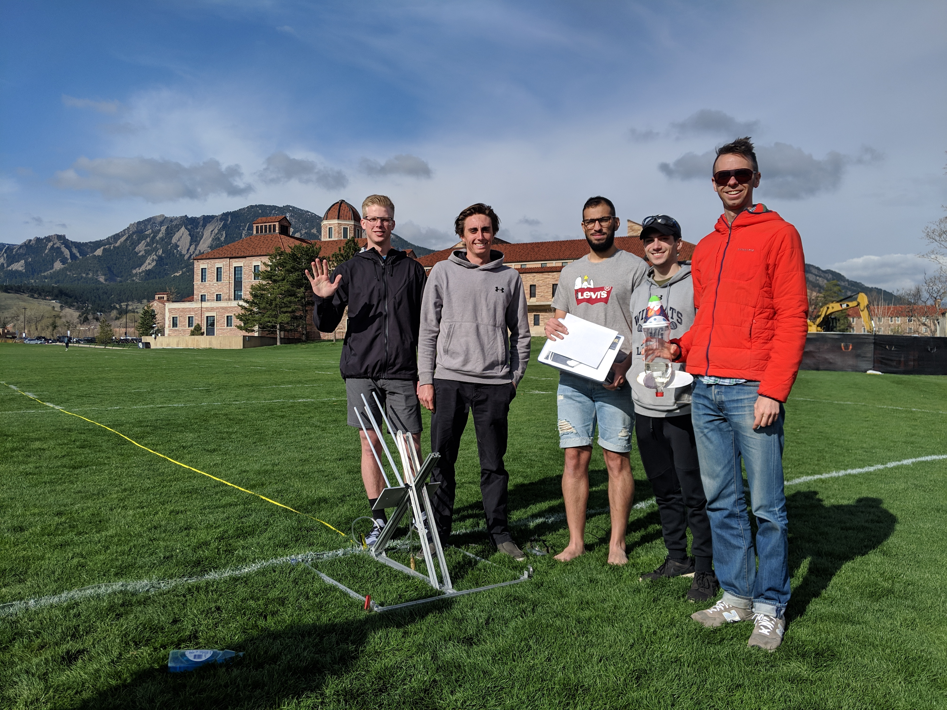
Rocket Lab
Group 5 - 8am Lab
Abdulla Al Ameri
Niko de Boucaud
Peter Hurst
Anders Olsen
Jack Soltys
Group 5 - 4/29/19
Notes:
Pete

Slide 2
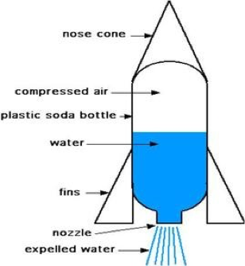
Table of Contents:
Baseline Design
Wind Tunnel/Static Test Stand
Matlab Modeling
Sensitivity Analysis
Modifications
Fabrication
Uncertainty Analysis
Flight Data
Staged Experiment
Lessons Learned/Conclusion
Group 5 - 4/29/19
Notes:
Pete

Slide 3
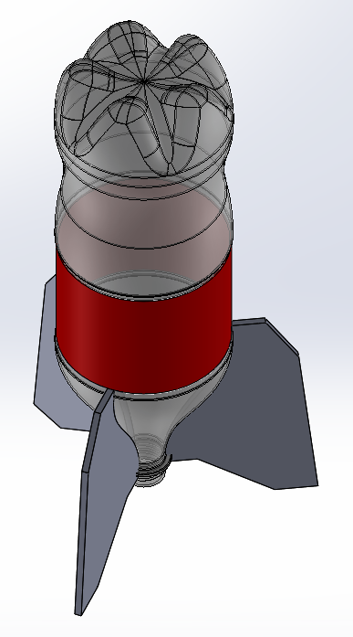
Baseline TA Design
Mass: 0.110 kg dry
Fins: triangle/rectangle shape, see picture
Geometry: Pointed party hat, plastic bottle
Area: 0.0095 m² frontal area
C_{D}: 0.348
Payload: altimeter
Foam cone attached with Gorilla glue to top of bottle
Foam cap enclosing altimeter, packing peanuts on top for protection
Indicator light/activation wire outside of nose cone
Allow to “breathe”
Figure 6: CAD of TA Baseline rocket
Group 5 - 4/29/19
Notes:
Pete

Slide 4
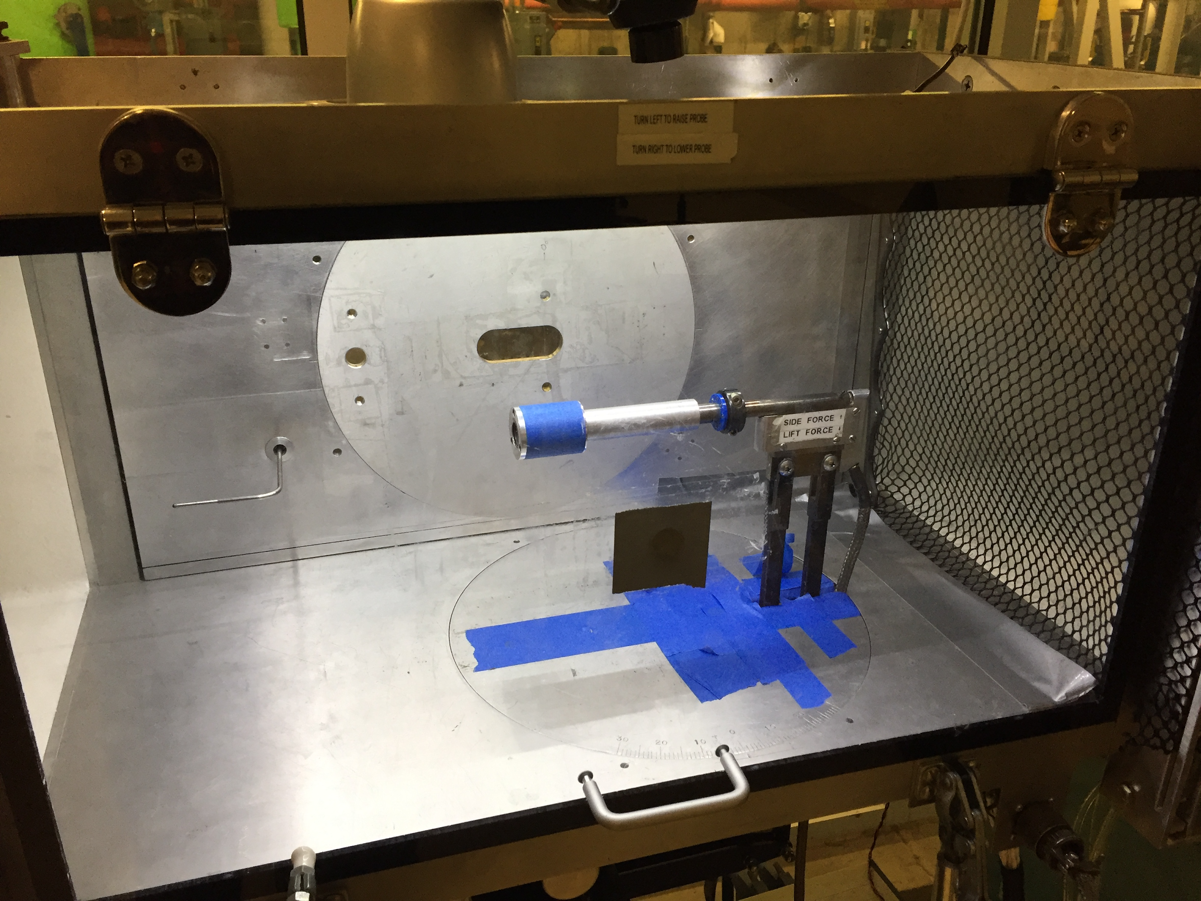
Wind Tunnel
Windtunnel measures force on the rocket or drag
C_{D} = Drag / (q * A)
q: Dynamic Pressure
A: Frontal Area
Non-spinning design
Less stable
Less potential drag
Wind Tunnel Test C_{D}:
TA Fins and Nose Cone: 0.348
Egg/plastic cup and Elliptical Fins: 0.343
Egg/Hat and Elliptical Fins: 0.322
Figure 5: Windtunnel set-up
Group 5 - 4/29/19
Notes:
Pete

Slide 5
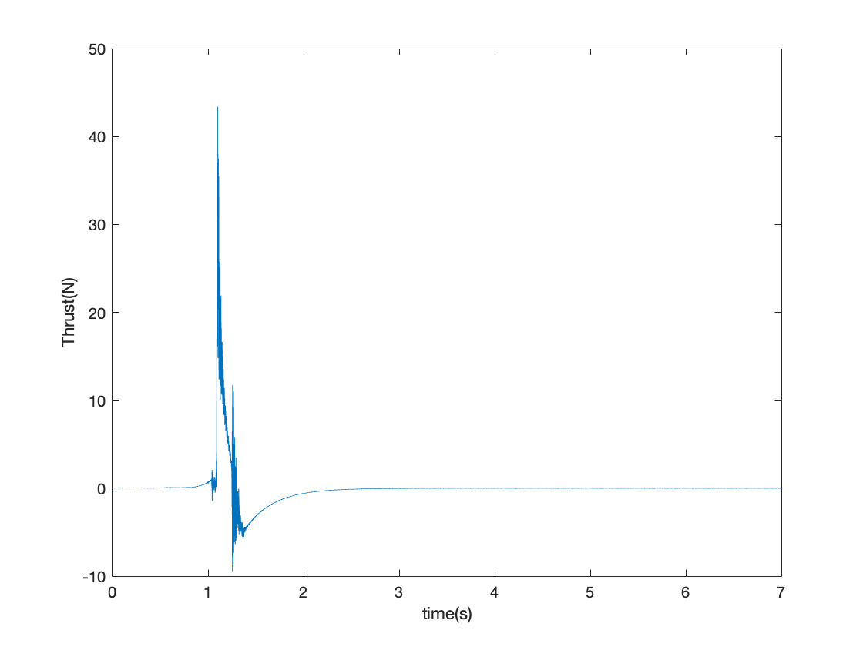
Static Test Stand
Measure thrust
Sensors measure force while propellant expelled
I = Force * time
I_{SP} = Impulse / (m_{prop}* g)
Trapz in Matlab to integrate under thrust curve
Figure 7: Thrust vs. Time
Group 5 - 4/29/19
Notes:
Pete

Slide 6
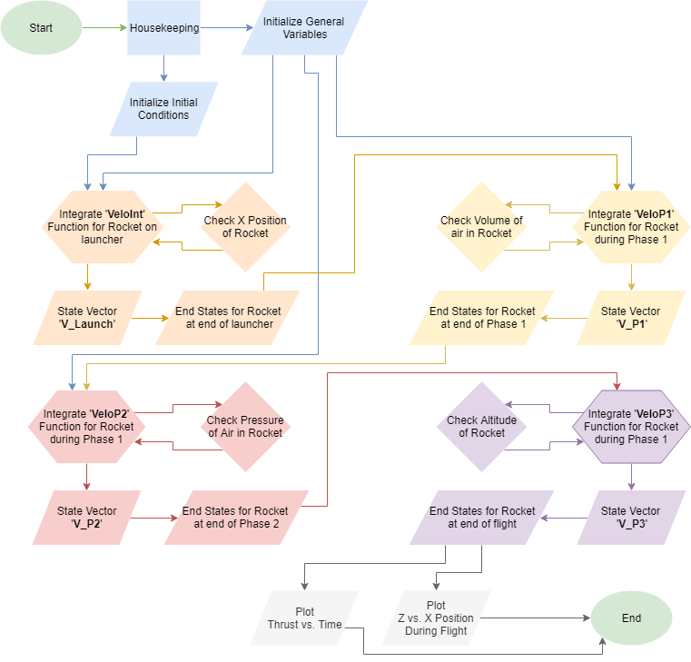

Matlab Modeling - Thermodynamic Model
Water Phase:
Air Phase:
Ballistic Phase:
Where: F = thrust force
V = velocity of propellant
ṁ = mass flow
m = mass
p = pressure
A = throat area
Figure 8: Functional block diagram
Group 5 - 4/29/19
Notes:
Jack

Slide 7
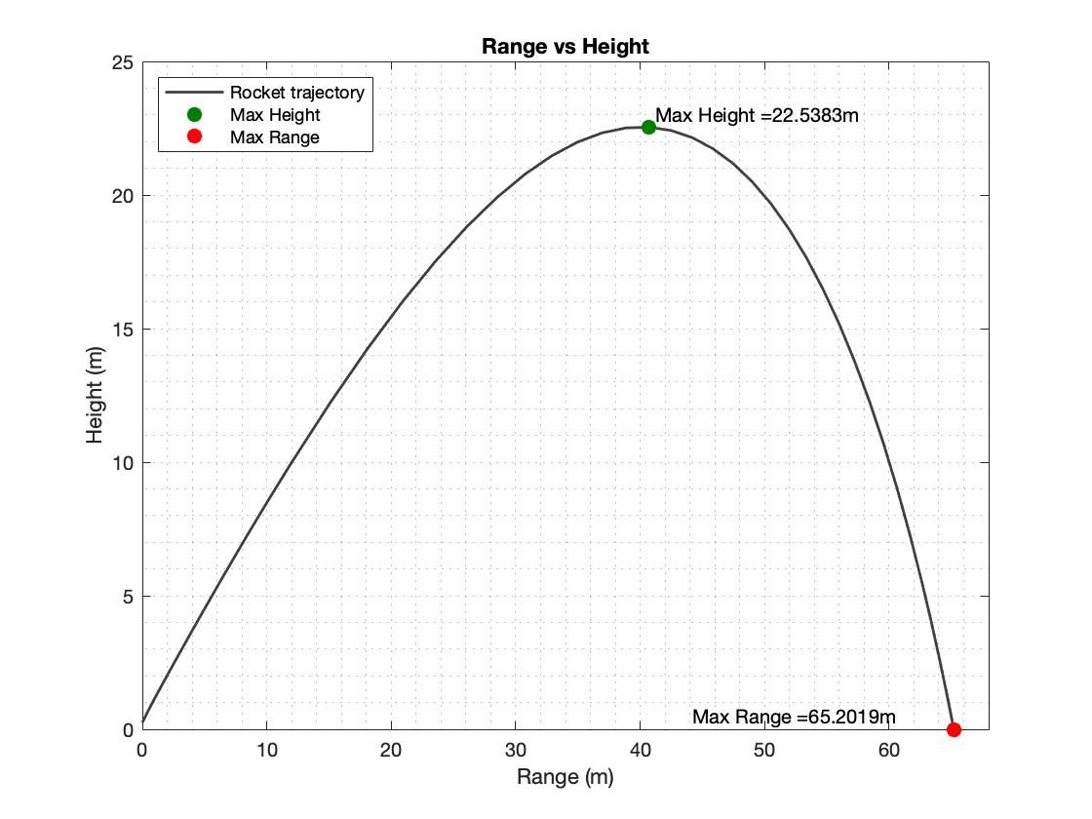
Matlab Modeling - Thermodynamic Model
Group 5 - 4/29/19
Notes:
Jack

Slide 8


Matlab Modeling - I_{SP} Model
Analyze thrust profile to estimate the rocket specific impulse by
Assumes all the thrust happens instantaneously
The rocket has initial given by
No water or air phase, the model starts from the ballistic phase.
Group 5 - 4/29/19
Notes:
Abdulla

Slide 9
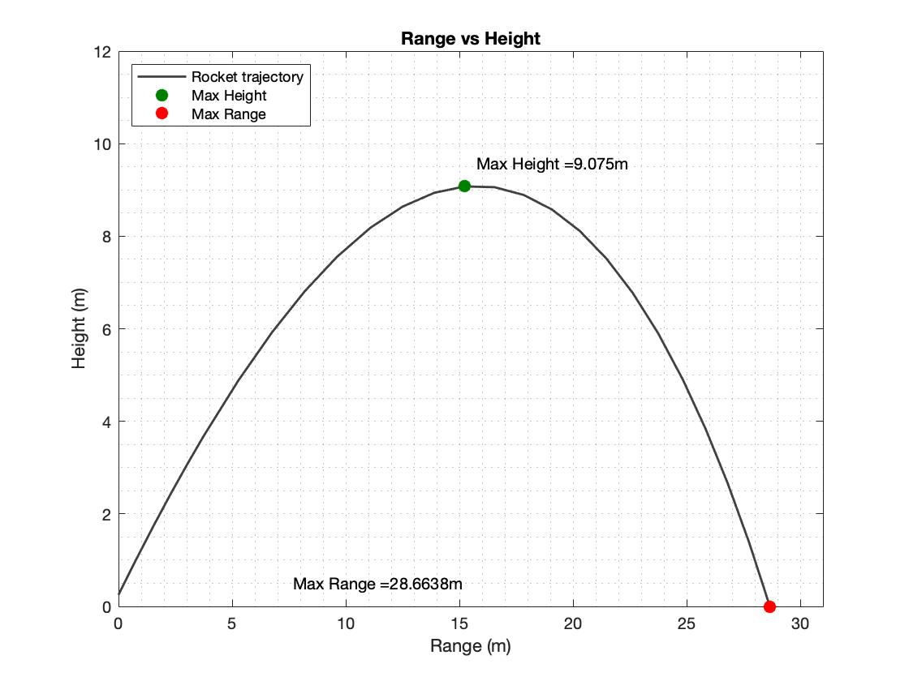
Matlab Modeling - I_{SP} Model
Group 5 - 4/29/19
Notes:
Abdulla

Slide 10
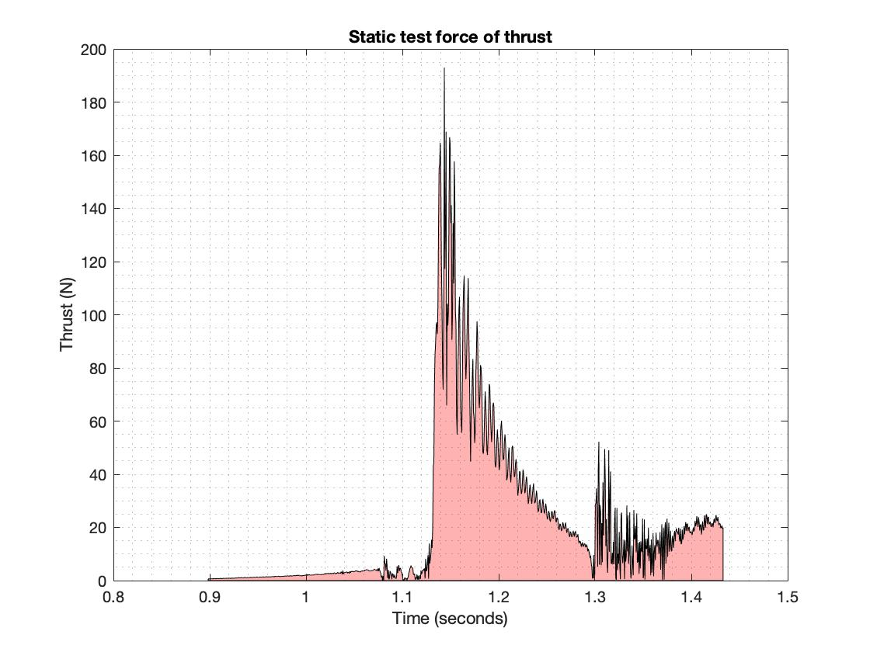
Matlab Modeling - Thrust Model
Extract the value of thrust for each point in time from the thrust profile.
Start from the water phase.
Figure: Force of thrust sample.
Group 5 - 4/29/19
Notes:
Abdulla

Slide 11
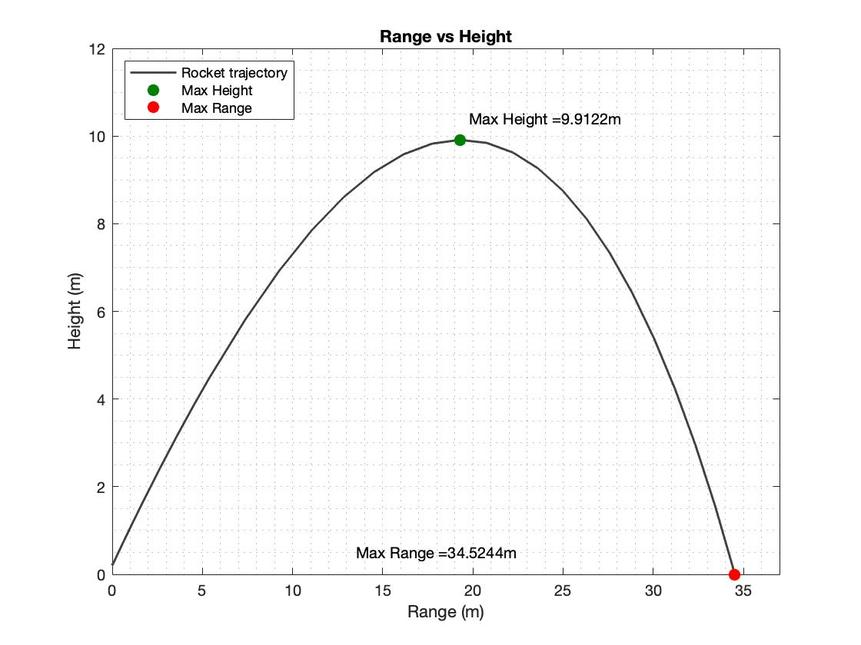
Matlab Modeling - Thrust Model
Group 5 - 4/29/19
Notes:
Abdulla

Slide 12
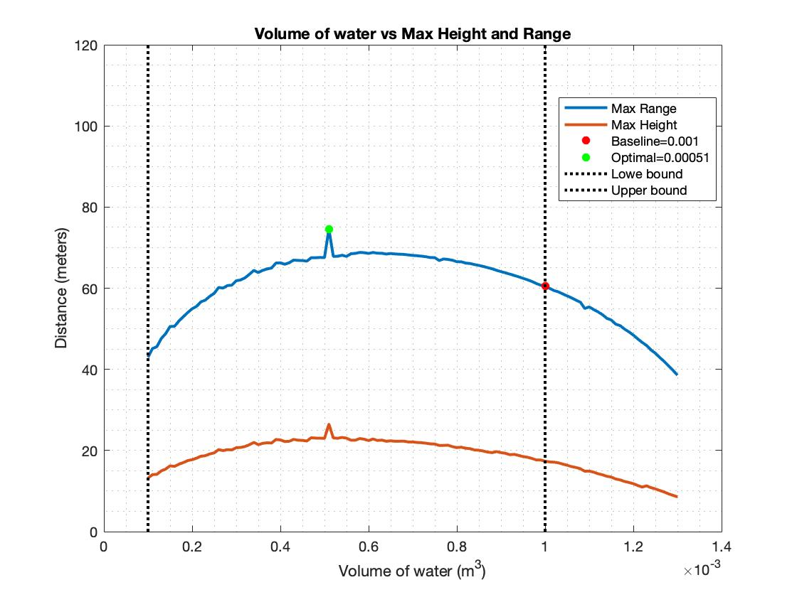
Sensitivity Analysis - Water Volume
Group 5 - 4/29/19
Notes:
Anders-Based on Matlab code, the ideal water volume was 0.51L. This was an outlier, thus we used 0.6L as the true max

Slide 13
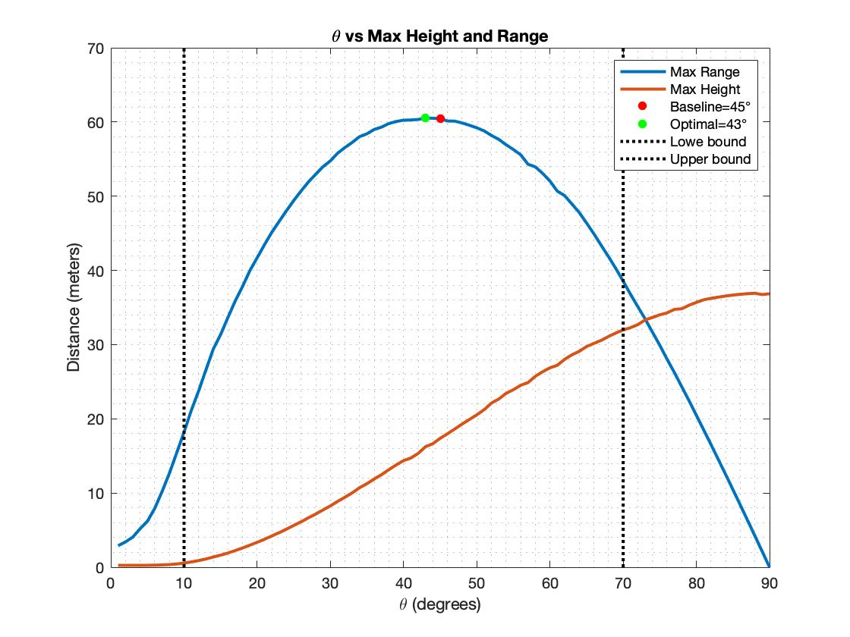
Sensitivity Analysis - Launch Angle
Group 5 - 4/29/19
Notes:
Anders-Based on Matlab code, the ideal water volume was 0.51L. This was an outlier, thus we used 0.6L as the true max

Slide 14
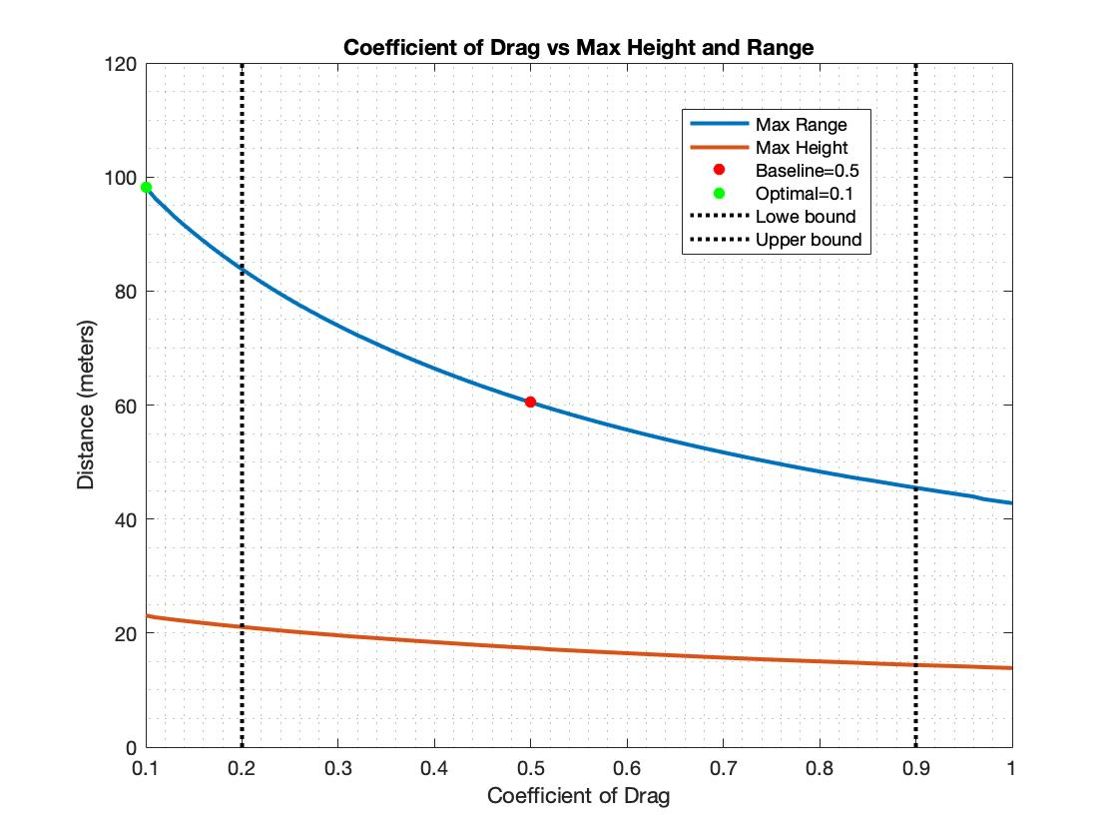
Sensitivity Analysis - Coefficient of Drag
Group 5 - 4/29/19
Notes:
Anders-Based on Matlab code, the ideal water volume was 0.51L. This was an outlier, thus we used 0.6L as the true max

Slide 15
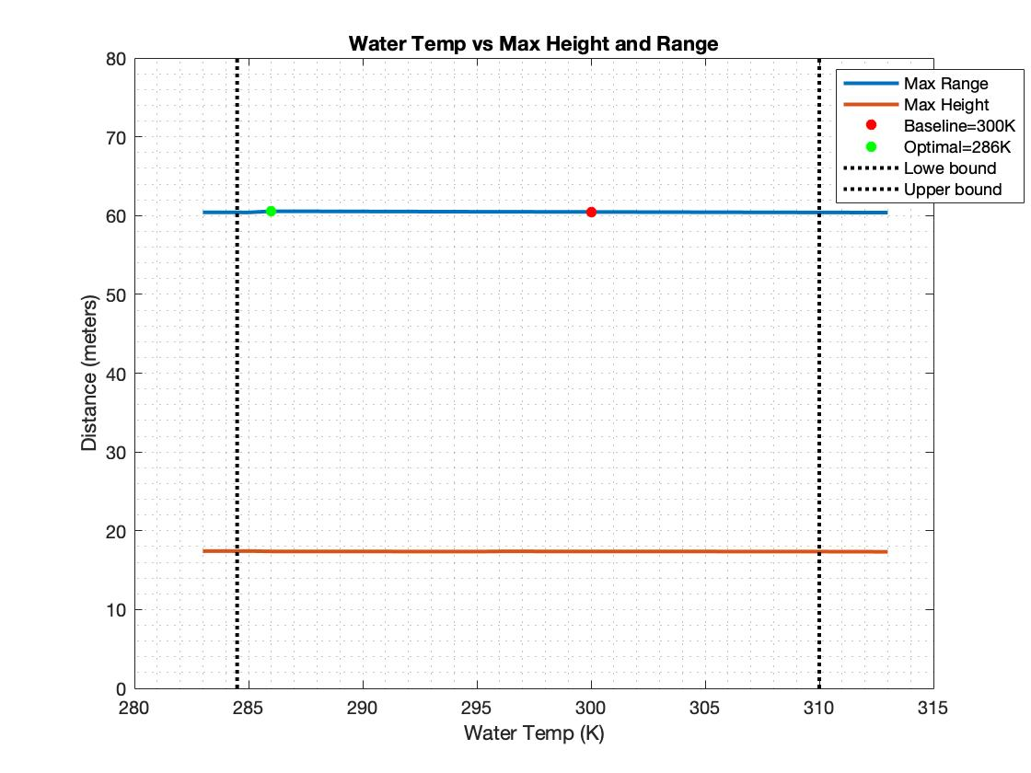
Sensitivity Analysis - Water Temperature
Group 5 - 4/29/19
Notes:
Anders

Slide 16
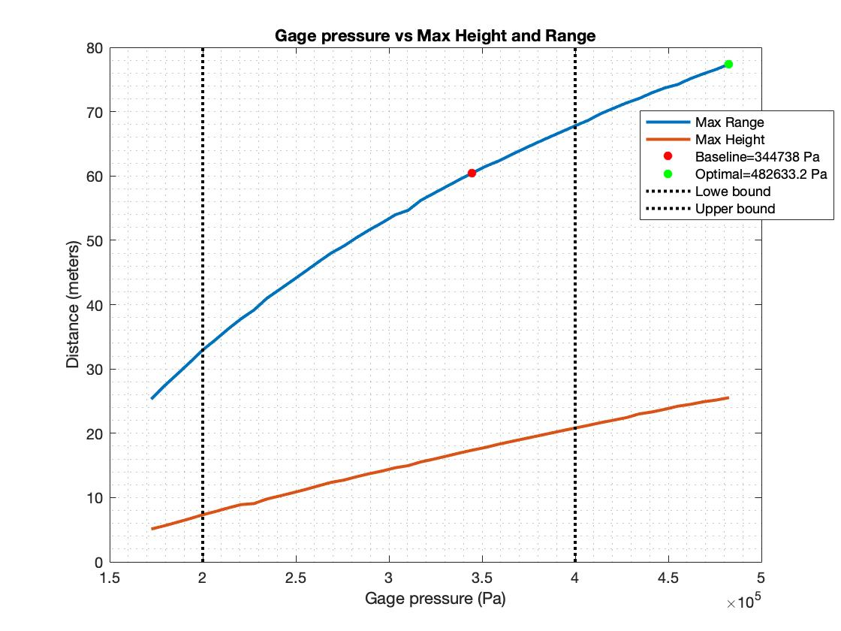
Sensitivity Analysis - Gage Pressure
Group 5 - 4/29/19
Notes:
Anders

Slide 17
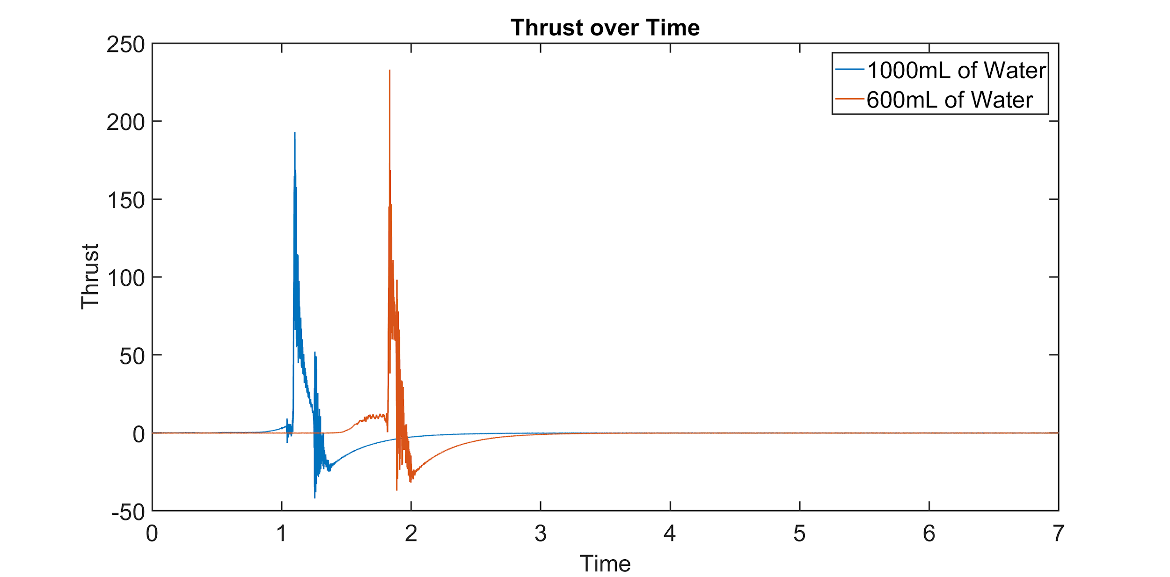
One Variable Changed
The one variable that was changed initially was the Water Volume
Changed from 1.0L to 0.6L
Provided increased thrust over baseline
Most sensitive variable to change from Thermodynamic Model
Disregarding Coefficient of Drag and Pressure
Figure 9: Thrusts vs Time
Group 5 - 4/29/19
Notes:
Niko

Slide 18
What was Changed for Optimization
Dry Mass: 0.110 kg
Thrust: 0.6L instead of 1.0L of water propellant
Fins: Elliptical
Geometry: Egg cup on party hat for “parabolic shape”
Area: 0.0095m² frontal area
C_{D}: 0.322
Payload: altimeter (same as TA baseline)
Optimized:
Drag ratio
I_{SP}
Distance
Group 5 - 4/29/19
Notes:
Niko

Slide 19
Modified Rocket Testing
Wind Tunnel Testing:
Rocket with modified fins and nose cone was tested in the wind tunnel
Two different nose cones were tested to achieve the minimum coefficient of drag
Modified Rocket 1: C_{D} = 0.343
Modified Rocket 2: C_{D} = 0.322
This was subsequently chosen to be the cone style for our final rocket
Static Test Stand Testing:
TA Baseline Water Volume (1.0L)
I_{SP} = 1.1653 s
Max Thrust = 192.95 N
Modified Water Volume (0.6L)
I_{SP} = 1.9858 s
Max Thrust = 233.0 N
Modified Water Volume resulted in a 20.8% increase in thrust force
Group 5 - 4/29/19
Notes:
Niko

Slide 20
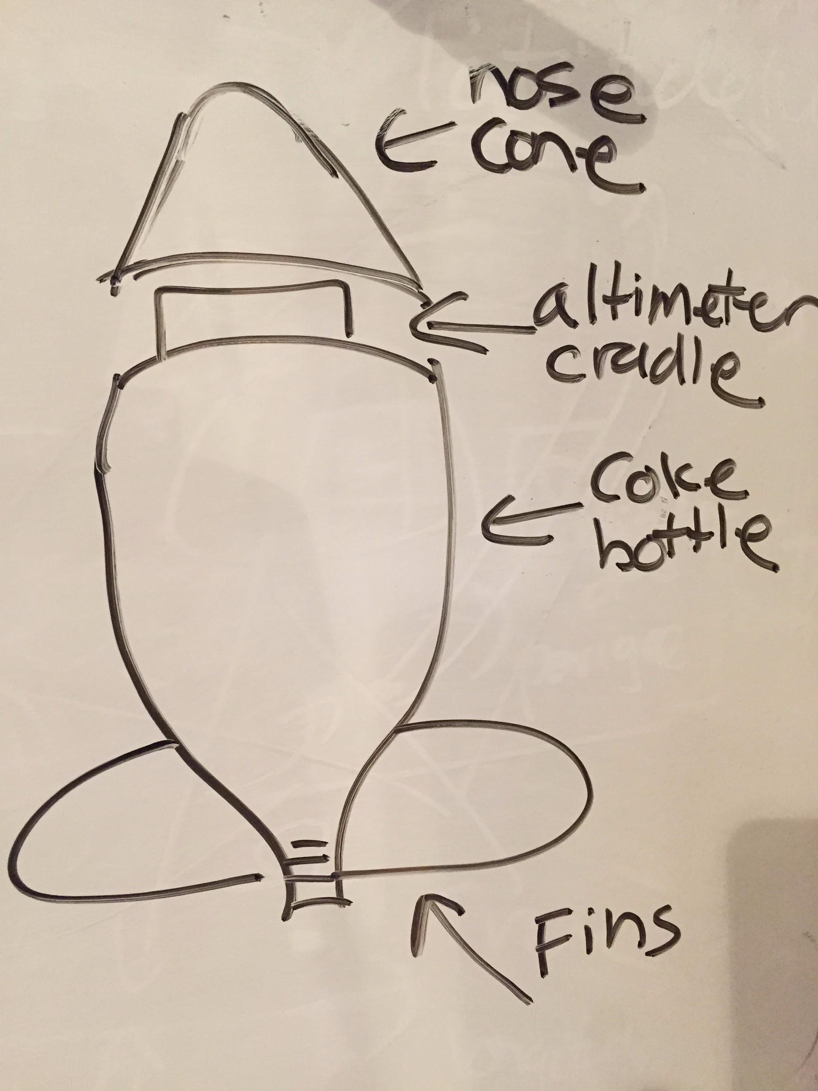
Fabrication
Coke bottle body
Standard for launch stand/pressurization
Poster board elliptical fins
Relatively light
Relatively stiff
Laser Cut
Leading edges sharpened with tape
Party hat with round egg cup tip
Electrical tape junctions
Easier to peel off without damaging fins/cone
More flexible than duct tape
Group 5 - 4/29/19
Notes:
Niko

Slide 21
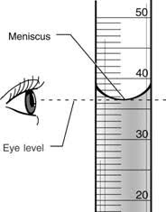
Uncertainties to Keep in Mind
Predicted Uncertainties
Wind speed and direction (normal)
Bottle pressure (normal)
Water volume (normal)
Other
Friction from launch stand
Proper initial propulsion off of rubber stopper
Change in center of mass through flight
Group 5 - 4/29/19
Notes:
Niko

Slide 22
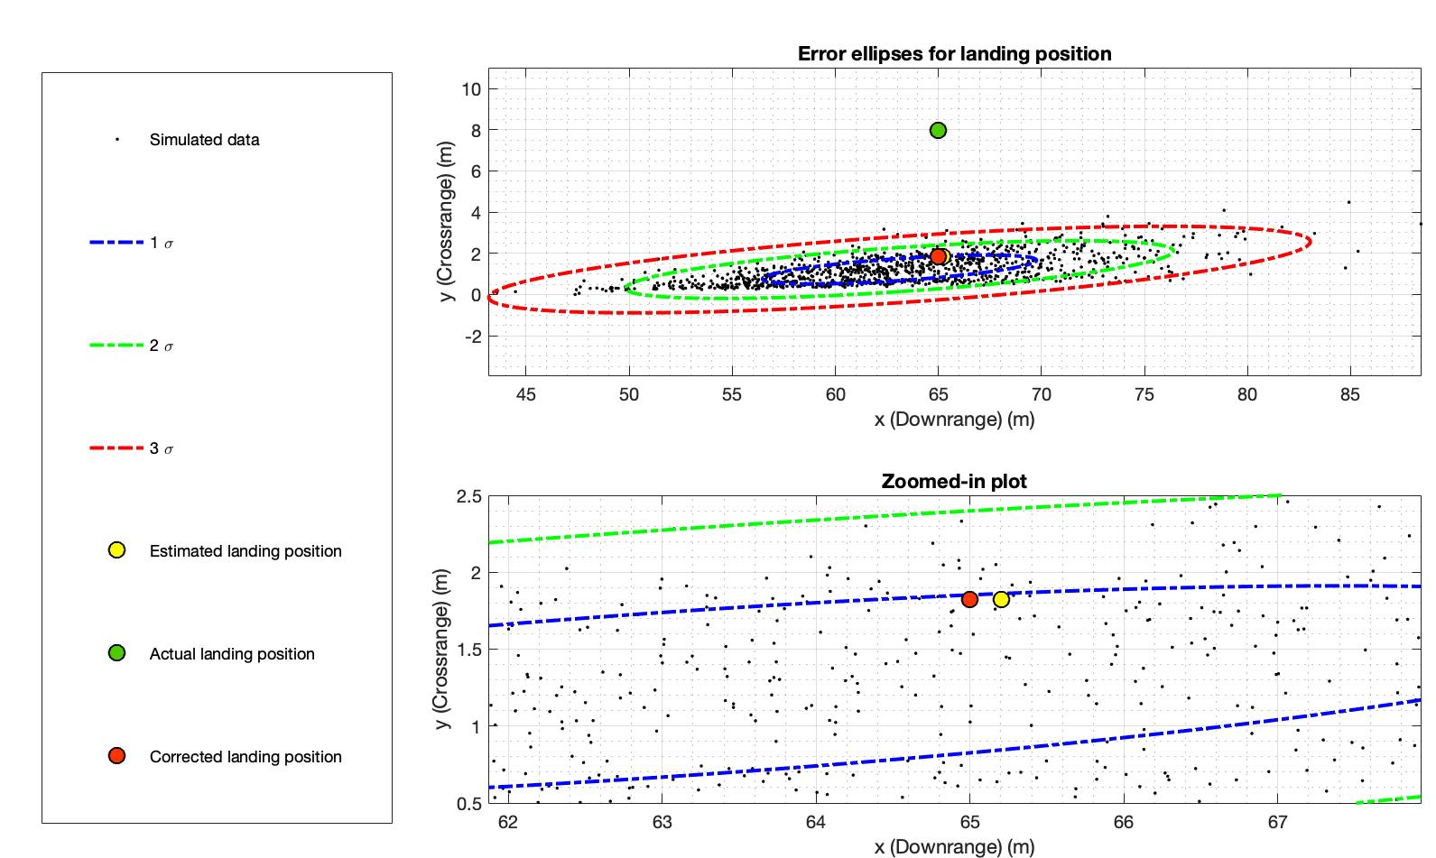
Error Ellipses - Launch 1, 1000 simulations
Launch 1:
Notes:
Abdulla-Monte Carlo Simulations provide a way to see how uncertainties in measured values affect the resulting downrange distance of the rocket
Normal Distributions were used for the variables with uncertainty
The variables were most likely to be near the desired values

Slide 23
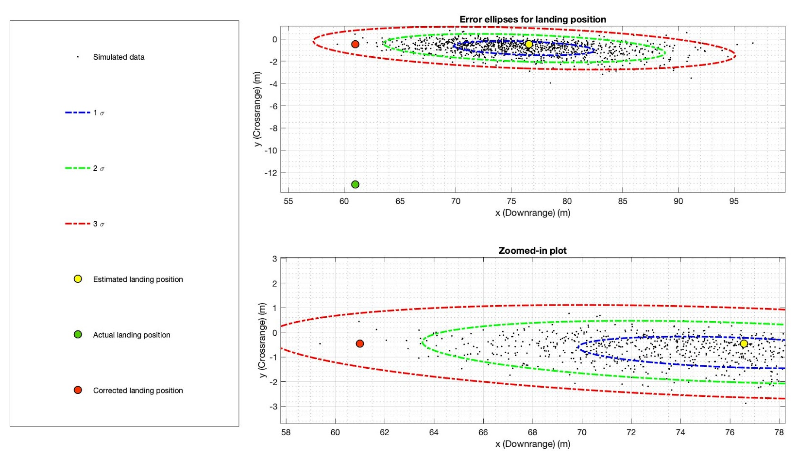
Error Ellipses - Launch 2, 1000 simulations.
Notes:
Abdulla

Slide 24
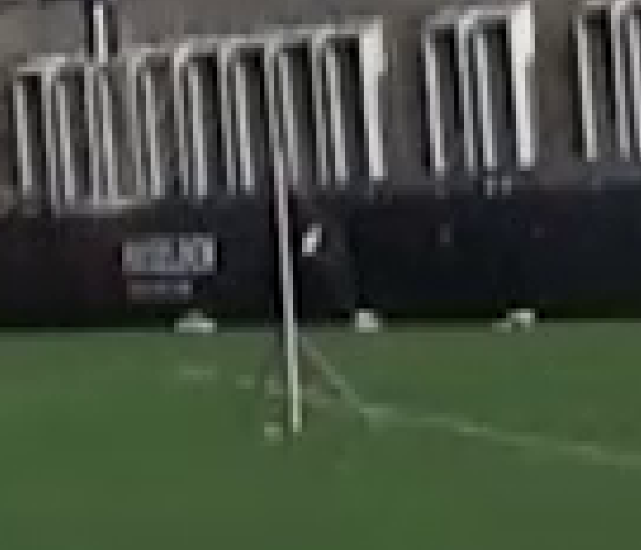
Data Analysis - Video Track
‘Tracker’ software was used to analyze the video data
Highly inaccurate data due to external sources of error
The video is low resolution, making it difficult to discern where the reference pole ends and the building behind it begins
Rocket leaves field of view at end of video
Camera is not perpendicular to flight path
Group 5 - 4/29/19
Notes:
Anders

Slide 25
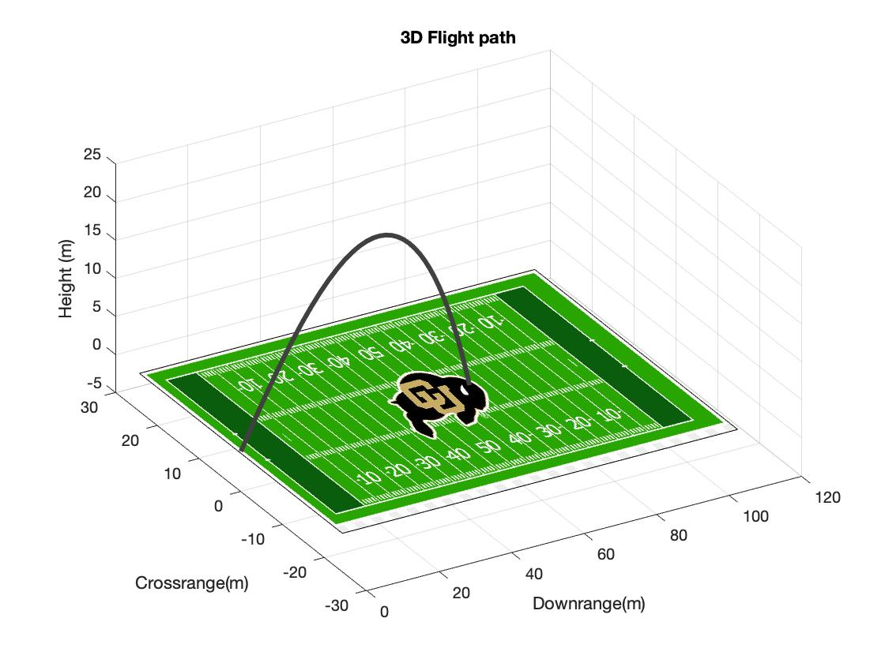
Flight Data
Flight Performance:
65 meters downrange
3.91 seconds in flight
7º to the left
35 meters high (Altimeter)
Environmental Data:
5 mph winds aloft from the West
16º Celsius
45º launch angle
Group 5 - 4/29/19
Notes:
Jack

Slide 26
Flight Parameters/Results
Rocket | Propellant | Design | Angle Launch (deg) | Range Predicted (m) | Range Actual (m) | Drift angle (Deg) | Altimeter height (m)
Single Modification | 0.6L water | TA fins and nose-cone | 45 | 65.2 | 65 | 7 (left) | 35.14
Optimized | 0.6L water | Elliptical fins, rounded nose-cone | 43 | 76.5 | 61 | 12.1 (right) | N/A
Exp 1 | 0.6L water | 2 stage | 48 | N/A | ~ 3 | N/A | N/A
Exp 2 | 0.6 & 0.3L water | 2 stage | 48 | N/A | ~ 11 | N/A | N/A
Group 5 - 4/29/19
Notes:
Jack

Slide 27

Notes:
Niko

Slide 28
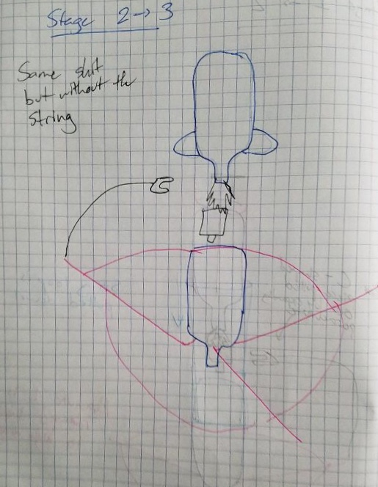
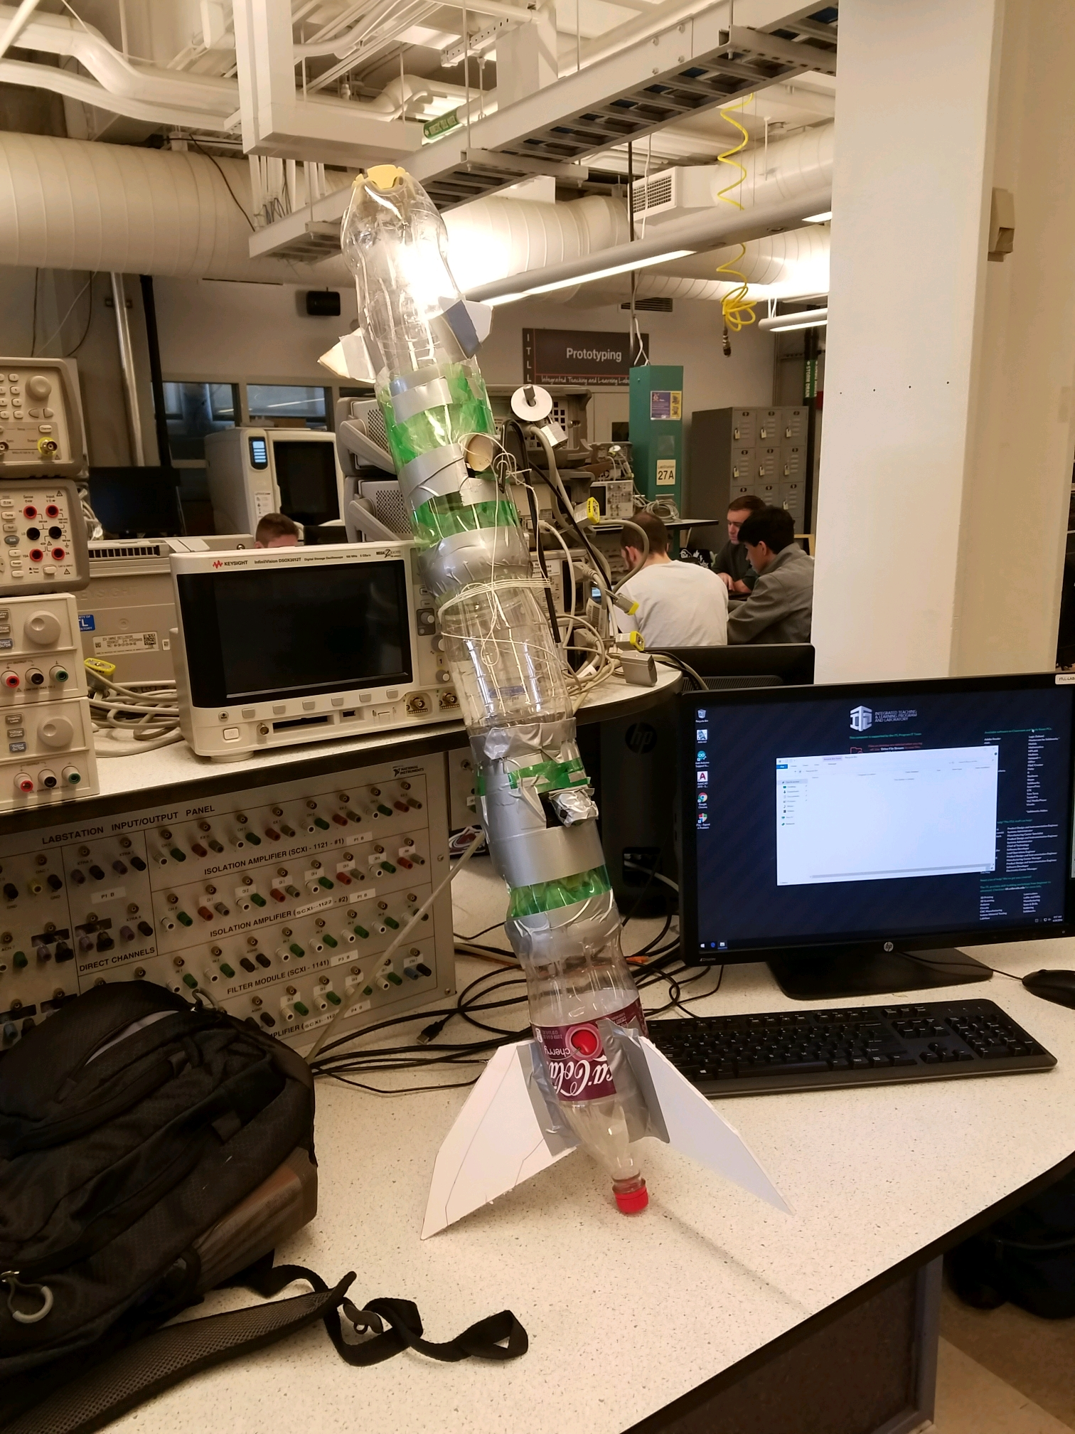
Three Stage Experiment
After baseline tests, used time to apply staging principles
3 stages
Separately pressurized bottles
Lightweight laser cut stopper holders to hold pressure in subsequent stages
Fins designed to induce spin
Centripetal motion designed to pull stopper mechanism during flight
Group 5 - 4/29/19
Notes:
NIko

Slide 29
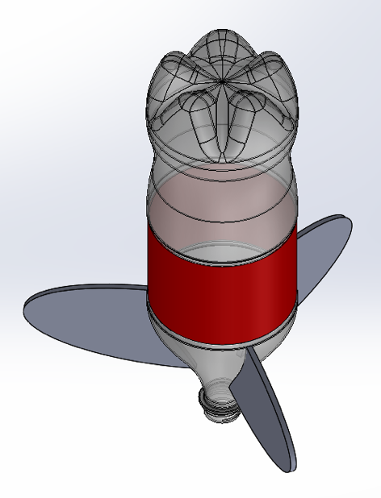
Conclusions
Takeaways:
Modified water volume made a large difference
Stability needed more attention when designing the optimized rocket
C_{D} changes provided minimal improvements
Difficult to make significant improvements
What We Would Do Next Time:
Spend more time perfecting the nose cone and fins
Do more testing in the wind tunnel
Group 5 - 4/29/19
Notes:
Anders

Slide 30
References
[1] Anderson, J.D. “Airfoils, Wings and Other Aerodynamic Shapes” Introduction to Flight, 8th Edition, McGraw Hill, New York, 2016 pp. 288-440.
[2] Bedford, A., Fowler, W., “Motion of a Point” Engineering Mechanics and Dynamics, 5th Edition, Pearson, New Jersey, 2008, pp. 50-51.
[3] Sellers, J.J. “Rocket Science”, Understanding Space, 3rd Edition, McGraw Hill, New York, 2005, pp 534-577.
Group 5 - 4/29/19
Notes:
Anders

